Slide 1
Event Handling

Slide 2
The Delegation Event Model
The event object generated by the source object is passed to one or more listeners.
A listener is an object with methods that process or handle the event.
The listeners do the work.
When you click the printer button, that event is sent to a listener object, which then sends a message to the printer. It’s not the button that notifies the printer; a listener does that.
A listener object waits until an event is passed to it. When the listener receives an event, the listener responds to the event.

Slide 3
The Source Object
The source object is the component which generates an event.
The event source may be a button, a textbox, a list, a mouse, a checkbox, a radio button, a key, a scroll bar, a menu item, or some other component

Slide 4
The Event Object
Event objects are generated automatically; they encapsulate information about the event, and the programmer chooses whether to handle or ignore the event.
When an event occurs, such as clicking a button, checking a checkbox, or pressing a key, an object belonging to a class that extends EventObject is automatically instantiated.

Slide 5
The Event Object
When a button is clicked or a menu item selected, an ActionEvent object is created.
When a checkbox is checked or unchecked, an ItemEvent is instantiated.
When a key is pressed, a KeyEvent is generated.

Slide 6
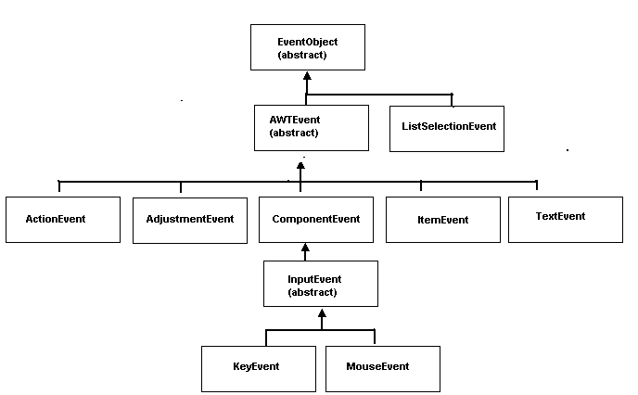
A partial view of the EventObject hierarchy

Slide 7
The Event Object
EventObject, which belongs to the java.util package defines two important methods:
Object getSource() returns the source of the event such as a reference to a particular button or checkbox, and
String toString() returns a string equivalent of the event.

Slide 8
The Listener
A listener waits or “listens” for an event to occur. A listener is automatically notified when certain events occur.

Slide 9
The Listener
When a button is pressed, a listener associated with the button is notified and responds.
When the mouse is clicked a “mouse listener” is sent a message and responds.

Slide 10
The Listener
Every listener must implement one or more listener interfaces.

Slide 11
The Listener
The listener responsible for the button event must implement the ActionListener interface in the java.awt.event package:
public interface ActionListener
{public void actionPerformed(ActionEvent e);
}

Slide 12
The Listener
To receive events from a source, a connection must be established between the source and a listener.
If no connection is established, the listener listens forever while the source generates unprocessed events.
It is the source’s job to register the listener by invoking a “registration method.”

Slide 13
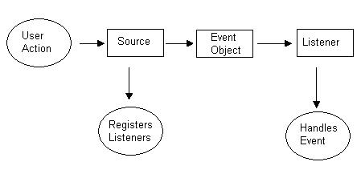
The event delegation model

Slide 14
The event delegation model
Event handling is a two step process:
Create a class that implements the appropriate listener interface(s).
Register the listener objects with the event source by using the “add___Listener” methods (e.g., addActionListener(…), addItemListener(…), addMouseListener(…), addKeyListener(…), etc). This registration makes the connection between the listener and the source.

